Slide 1

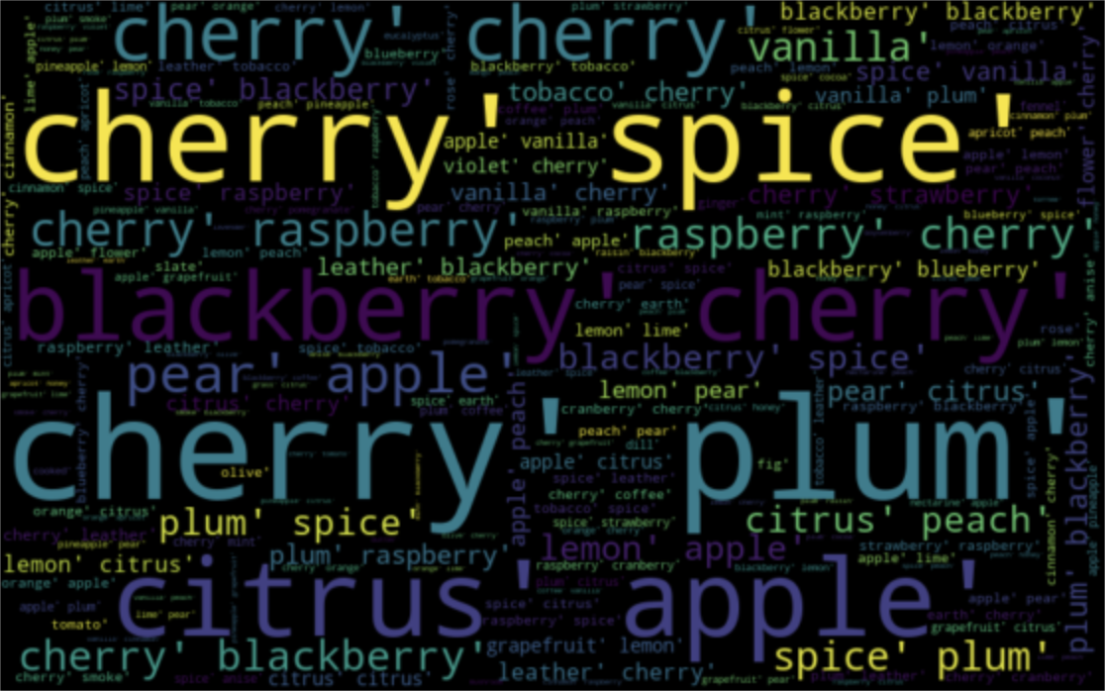
Wine review
Cate Soane, Toni Anderson, Alex Schackmuth

Slide 2
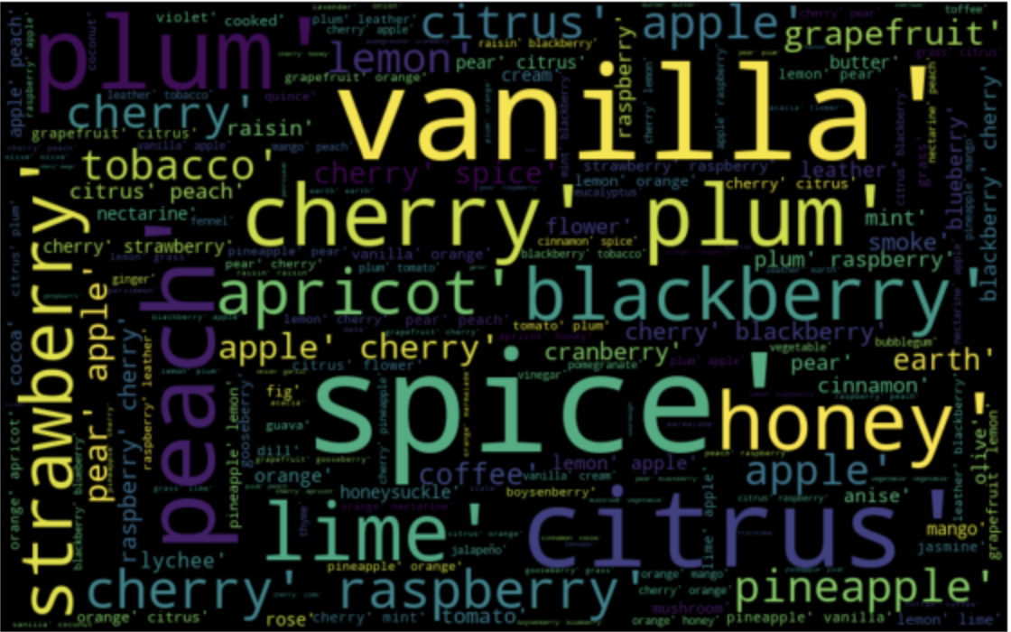
Why?
How is price determined?
Are there any correlations between
Region
Score
Year
Word Count etc.

Slide 3
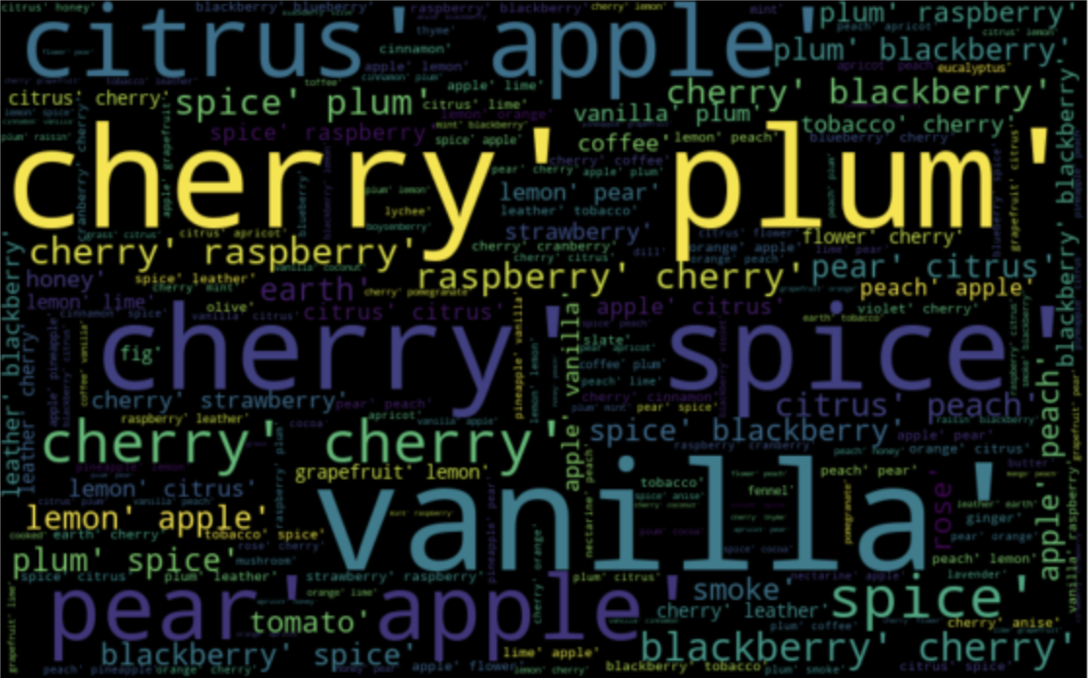
Data Collection
Kaggle:
CSV containing scraped Twitter data
Flavor Notes:
Found on separate website

Slide 4
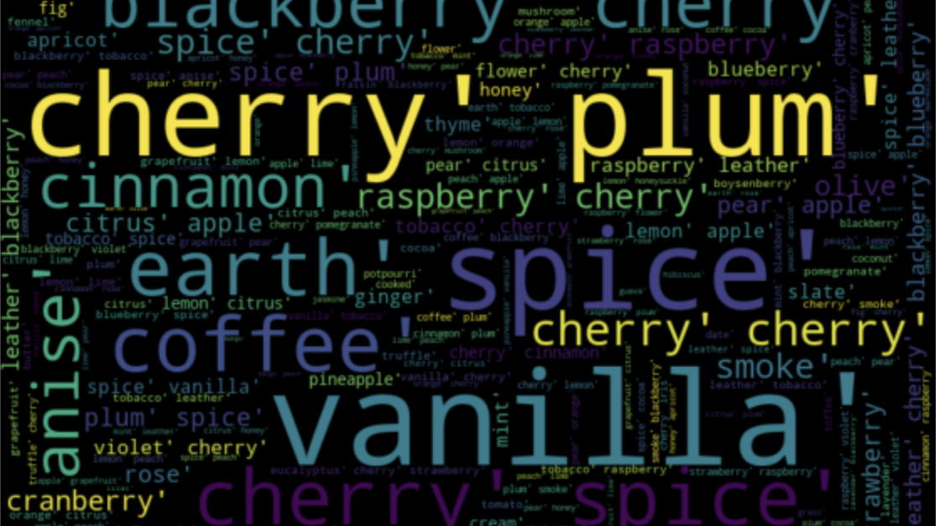
Data Cleaning
Removed columns
Filtered description
Binned scores
Grouped by continent

Slide 5
Technology used
Python
Jupyter Notebook
Machine Learning
Tableau

Slide 6
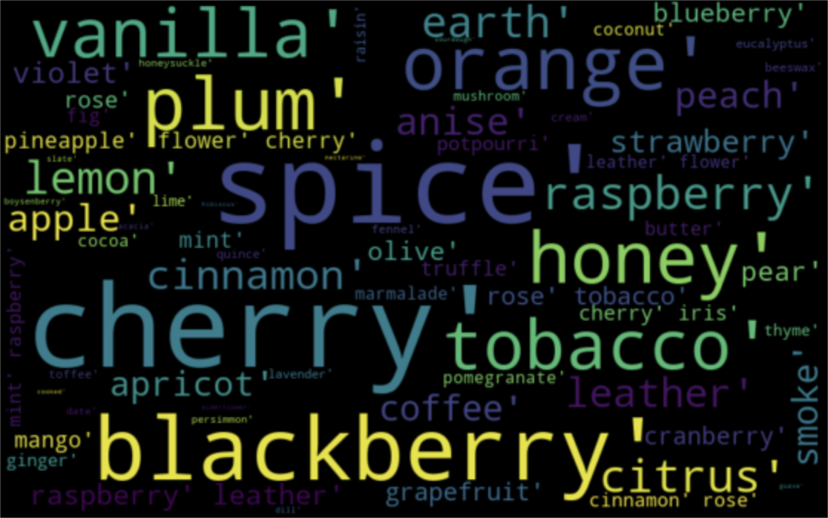
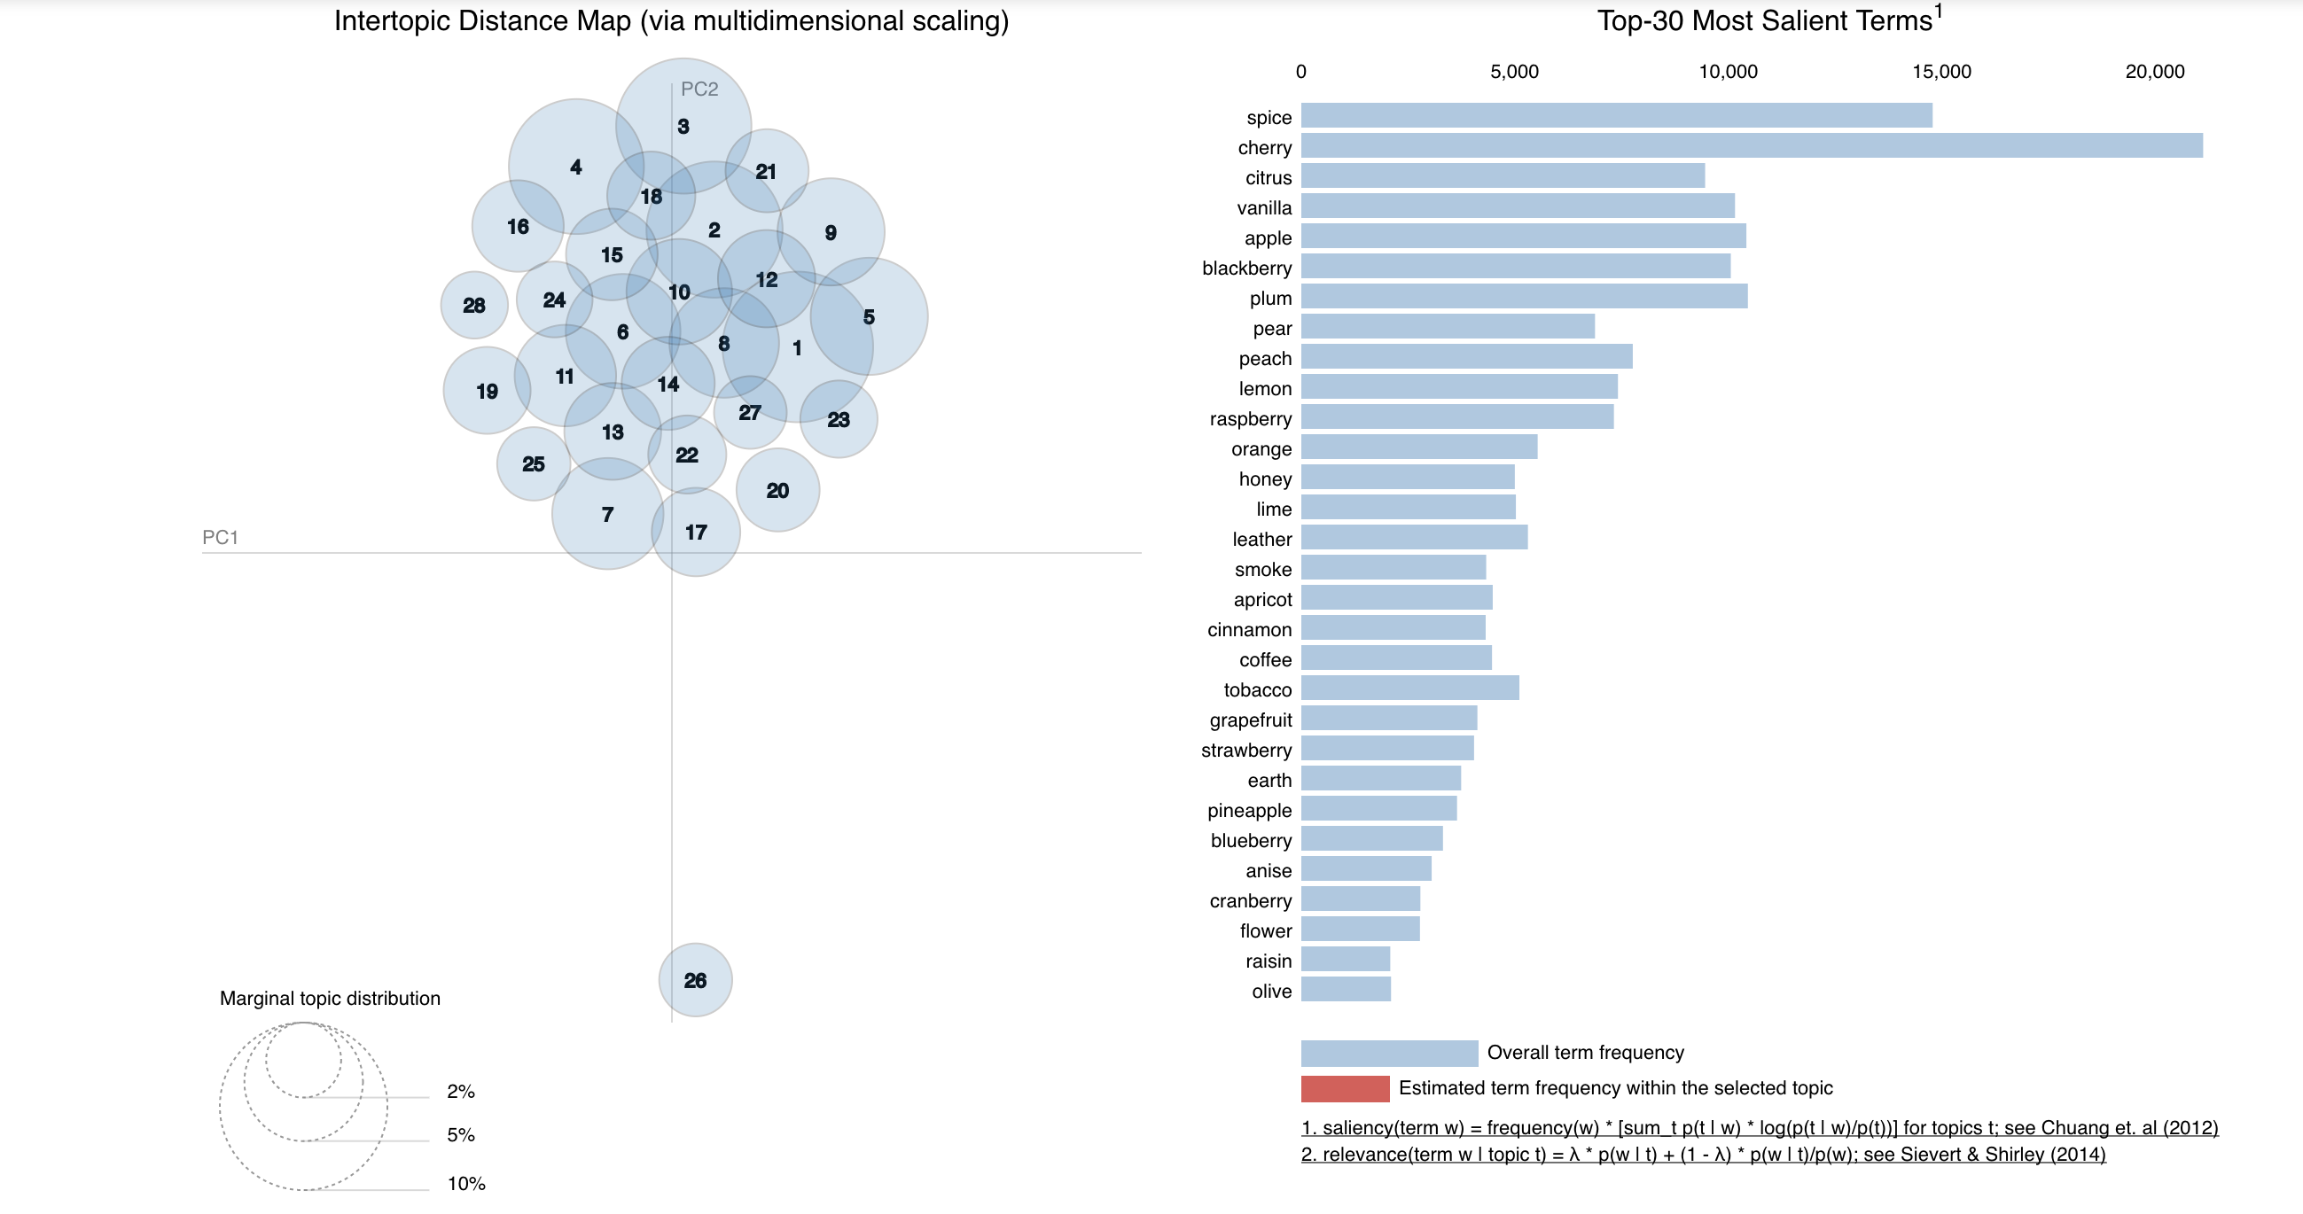
Data Exploration: Clustering
Notes:
Using only the words in our flavor list..
Our interactive visualization tool for topic models fit using LDA
To use the visualization tool, click a circle in the left panel to select a topic, and the bar chart in the right panel will display the 30 most relevant terms for the selected topic, where we define the relevance of a term to a topic. The red bars represent the frequency of a term in a given topic, and the blue bars represent a term's frequency across the entire collection of written texts ( in our case the reviews ).
Topic modeling is a type of statistical modeling for discovering the abstract “topics” that occur in a collection of documents. Latent Dirichlet Allocation (LDA) is an example of topic model and is used to classify text in a document to a particular topic.
Size stands for marginal topic distribution

Slide 7
Regression: Price vs. Score

Slide 8
Regression: Flavor Notes vs. Score

Slide 9
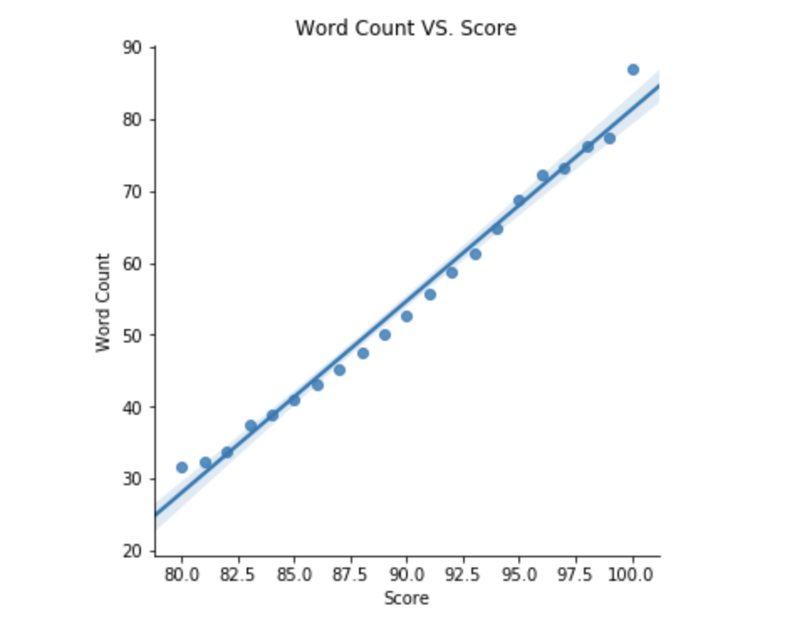
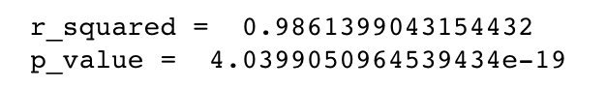
Regression: Review Length vs. Score
Notes:
Used regression analysis…
Discovered that we have a near perfect correlation between the word count in a review and it’s score.
This suggests that the better the wine the more time and detail someone puts into a review

Slide 10
Sankey / Continent map

Slide 11
Alex’s Model???

Slide 12
DEMO

Slide 13
Limitations
The data we used
Too many categorical values for each variable

Slide 14
Conclusion
Subjectivity of taste
Amateur wine enthusiasts
Length of review = best correlation

Slide 15
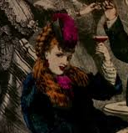
Cheers!

